Slide 1


The week before last week
Finished the loop A behavior simulation.

Slide 2
Structure
Ctrl Logic
Pooling
Global buffer
Ifm_addr_gen
Accumulator
Ifm_matrix_buf
Img2col_ifm
Ifm_buf
wgt_matrix_buf
Img2col_wgt
Wgt_buf

Slide 3
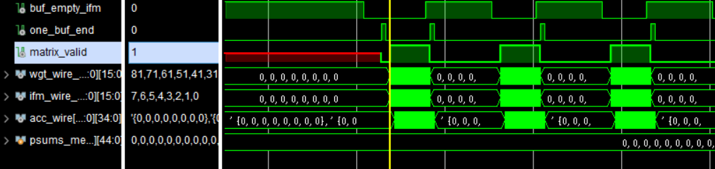
Simulation result
total:250ns/10ns idle:160ns/10ns busy:90ns /10ns

Slide 4
Efficiency
Input: eight 28*28 tiles of 8 ifmap channels
Output: eight 26*26 tiles of 8 ofmap channels
Resources: 512 multipliers
Actual total time: 2133 cycles
Ideal time: 26*26*9*8÷512*8=768 cycles
Efficiency: 36%

Slide 5
Last week
Re-designed the DLA structure to improve the convolution efficiency.

Slide 6
Structure
Ctrl Logic
Ifm_addr_gen
Accumulator
Ifm_matrix_buf
Img2col_ifm
Ifm_buf
Arbitrator
Ifm_matrix_buf
Img2col_ifm
Ifm_buf
Matrix Fetcher
Ifm_matrix_buf
wgt_matrix_buf
Img2col_wgt
Wgt_buf

Slide 7
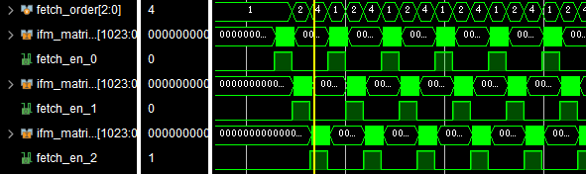
Simulation result
轮流到3个 ifm_matrix_buf 中取数据。

Slide 8
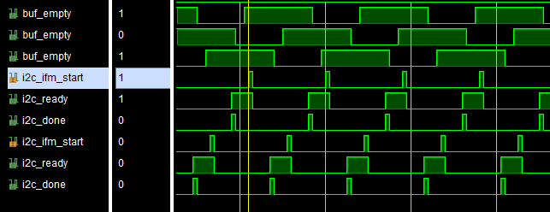
Simulation result
两个img2col_ifm模块轮流工作，输出数据到空的 ifm_matrix_buf 中。
可以发现，每一个时刻都有buffer是空的，所以img2col_ifm单元不会休息，几乎一直在工作。

Slide 9
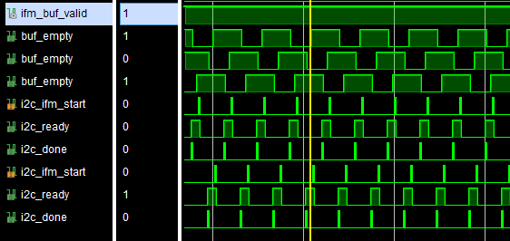
Simulation result
可以看到在任一时刻都有 ifm_matrix_buf 是满的，所以 matrix_fetcher 可以不间断地取数据输入cubic单元中进行计算。

Slide 10
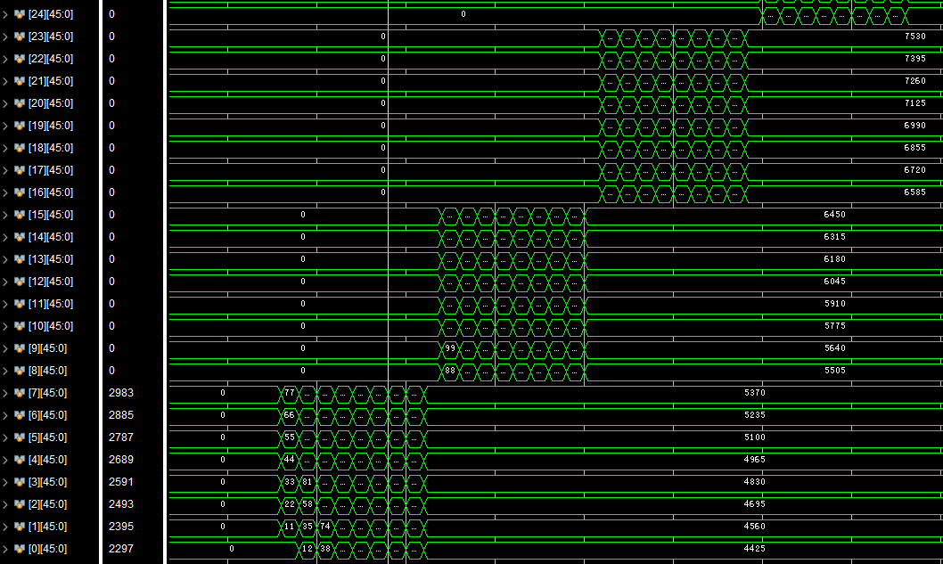
Simulation result
可以更进一步地看到累加器的存储空间在每个周期里都在吸收新的结果数据。

Slide 11
Efficiency
Input: eight 28*28 tiles of 8 ifmap channels
Output: eight 26*26 tiles of 8 ofmap channels
Resources: 512 multipliers
Actual total time: 807 cycles
Ideal time: 26*26*9*8÷512*8=768 cycles
Efficiency: 95.167%

